Slide 1
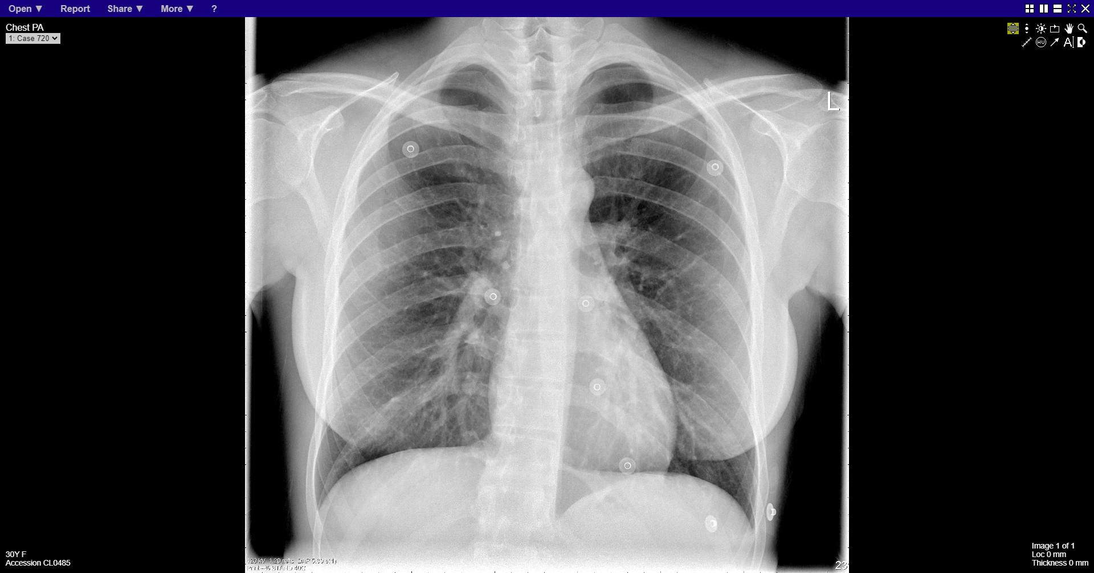
Notes:
normal

Slide 2
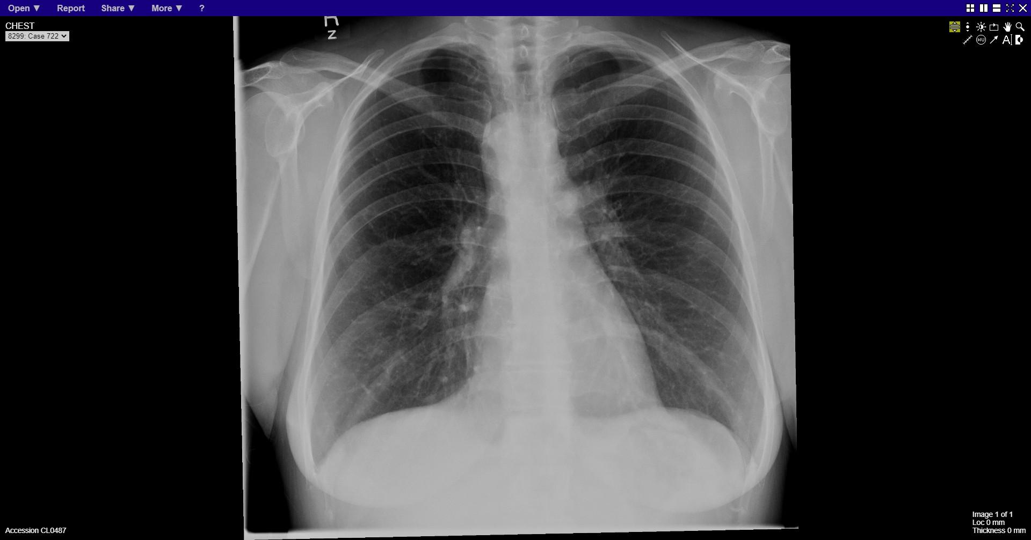
Notes:
Right sided aortic arch

Slide 3
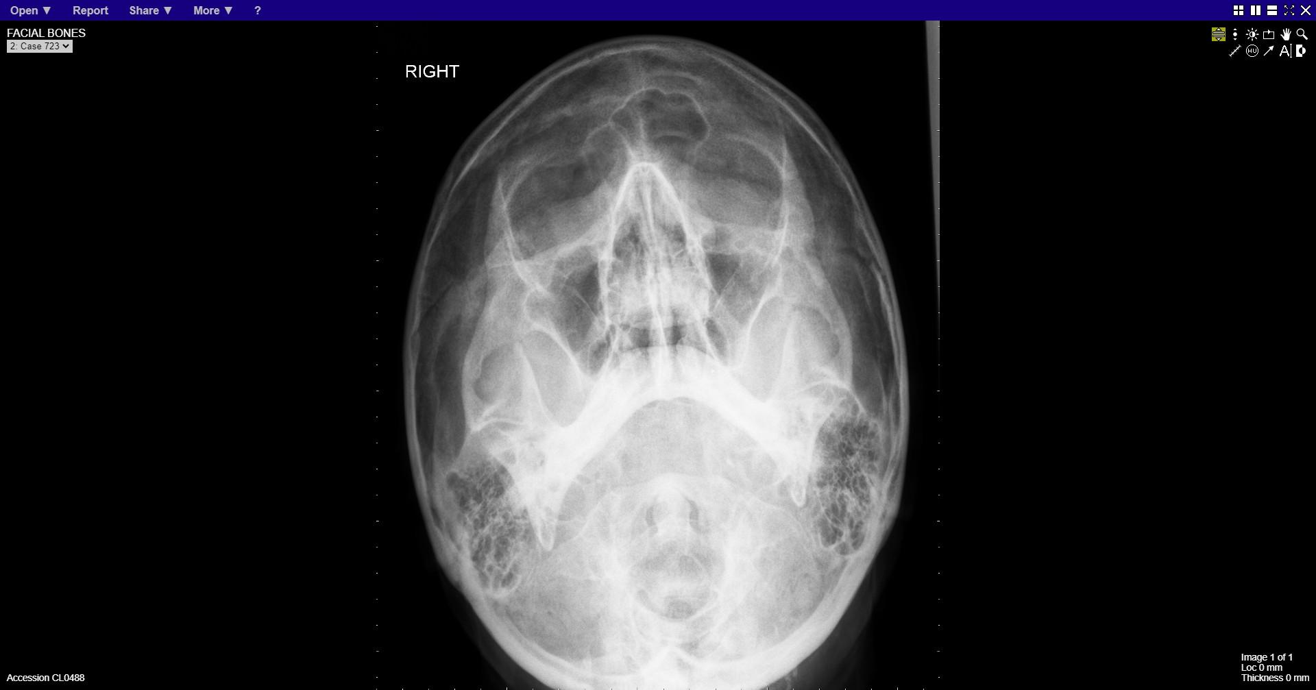
Notes:
normal

Slide 4
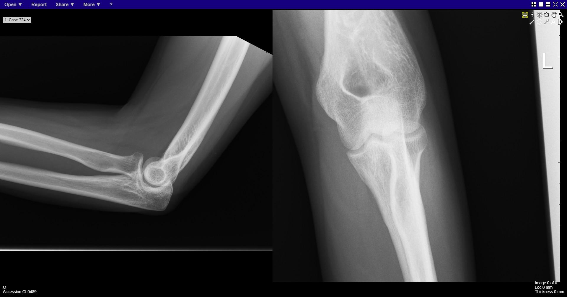
Notes:
normal

Slide 5
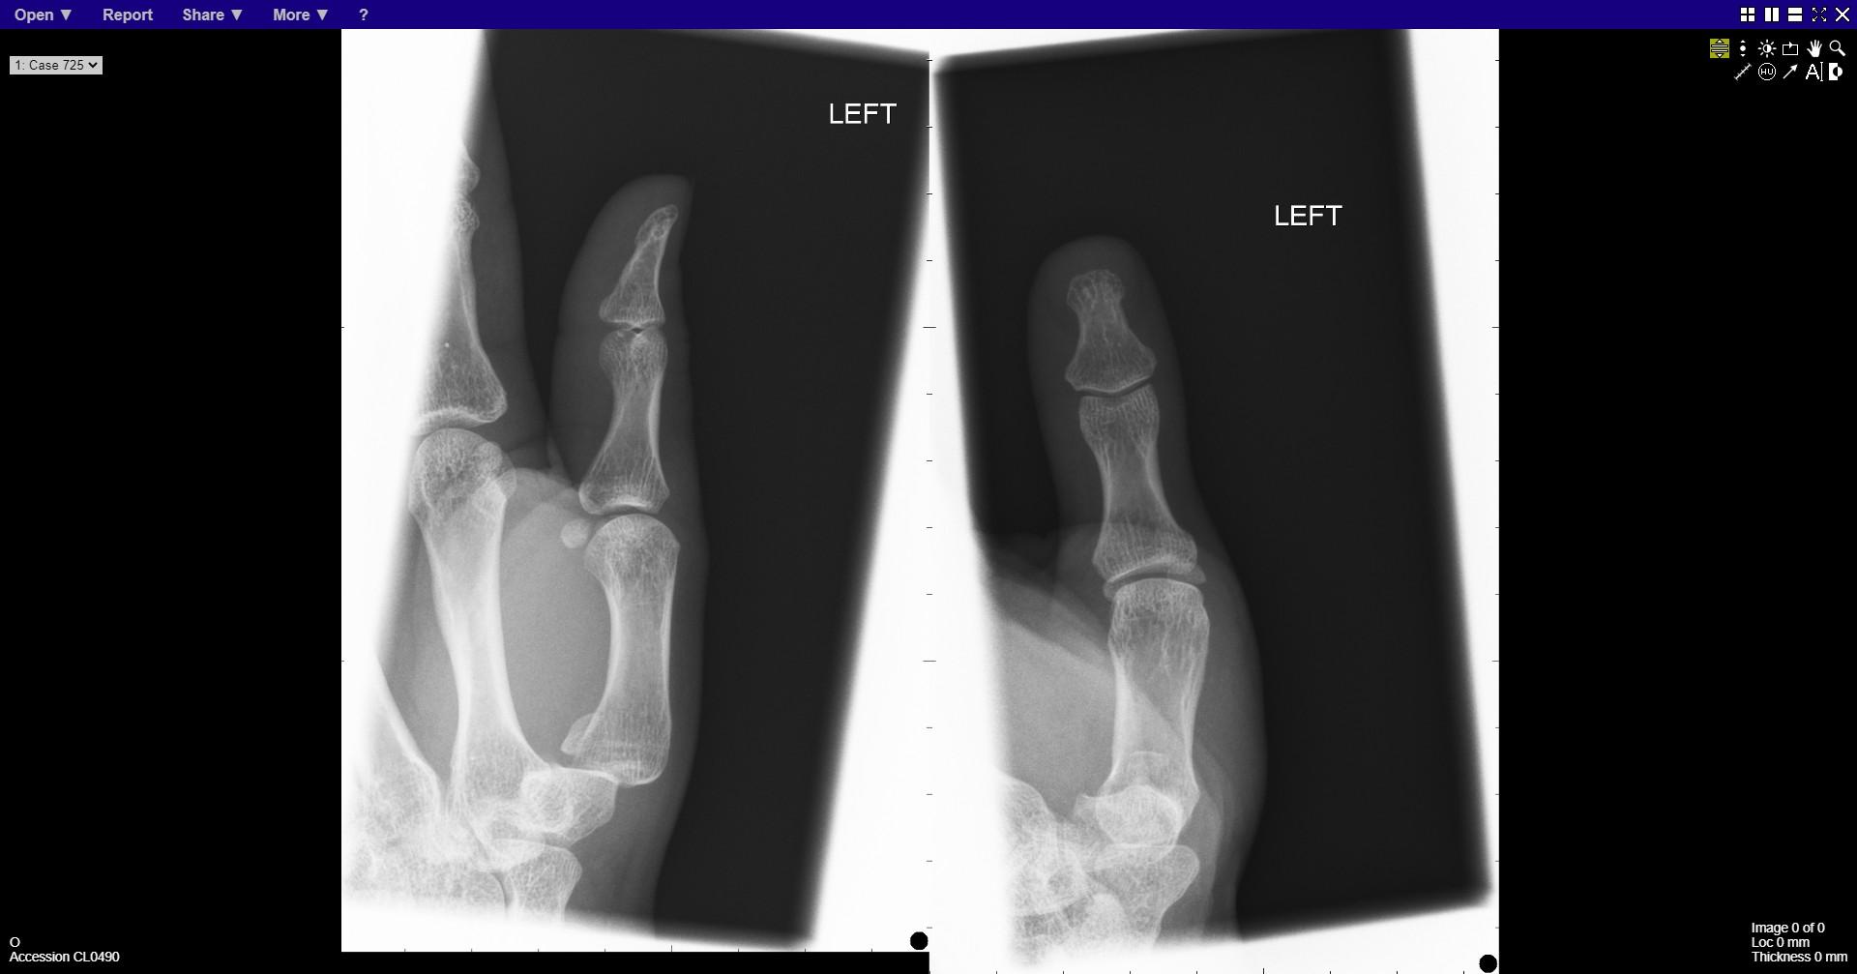
Notes:
Fracture base of 1st metacarpal

Slide 6
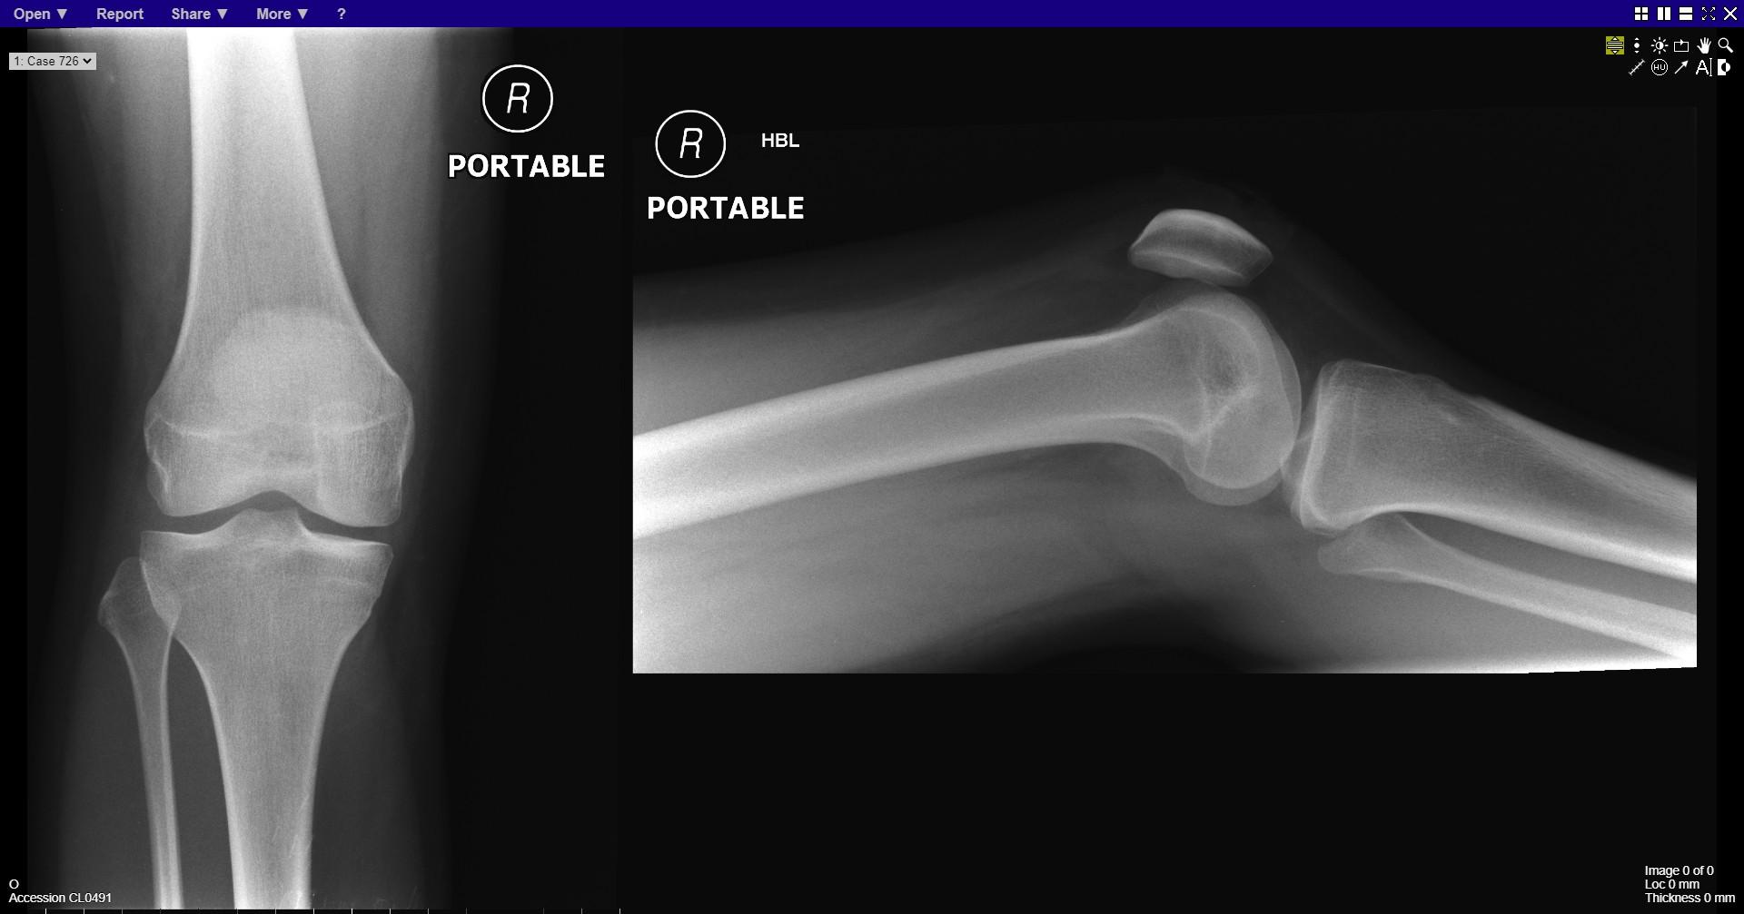
Notes:
normal

Slide 7
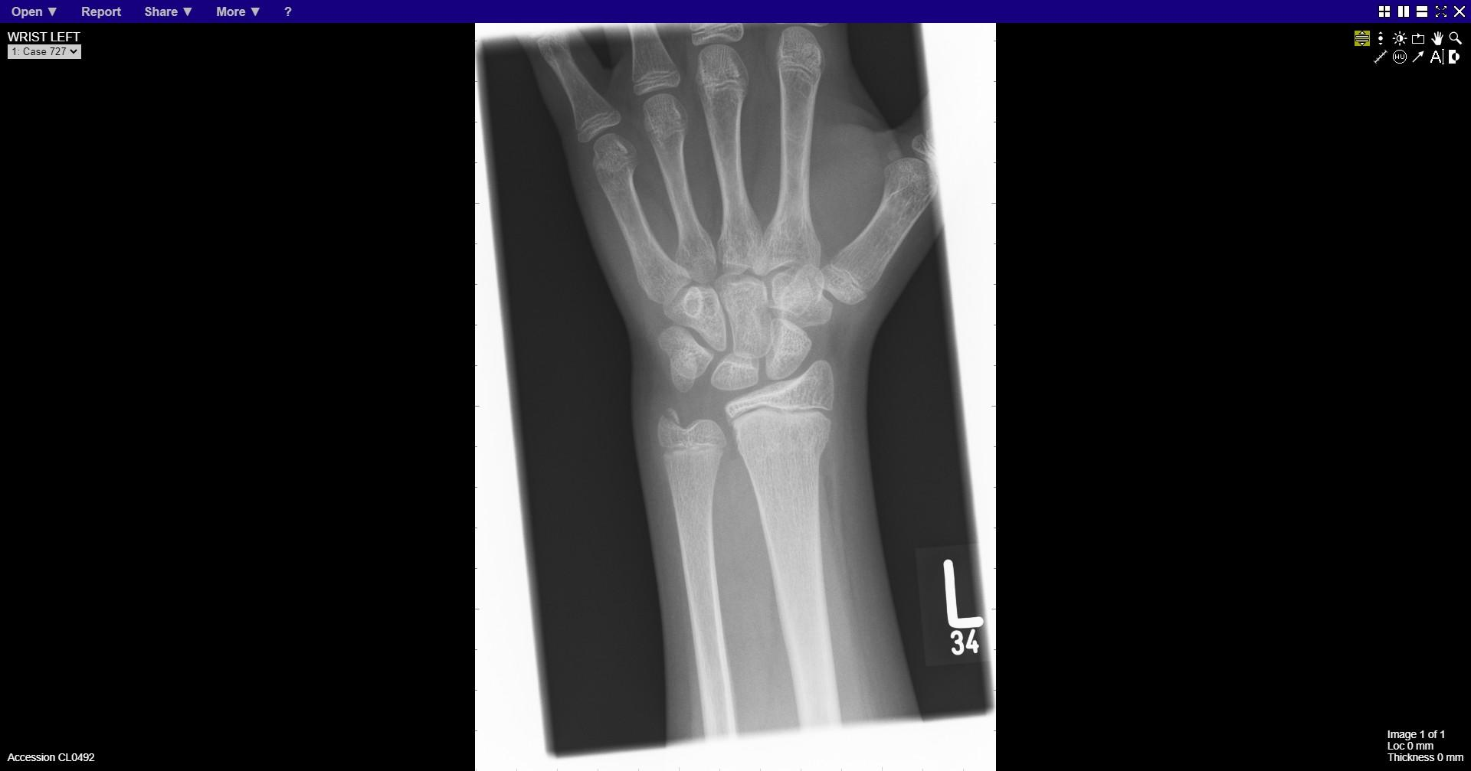
Notes:
Ulnar styloid fracture
Distal radial fracture

Slide 8
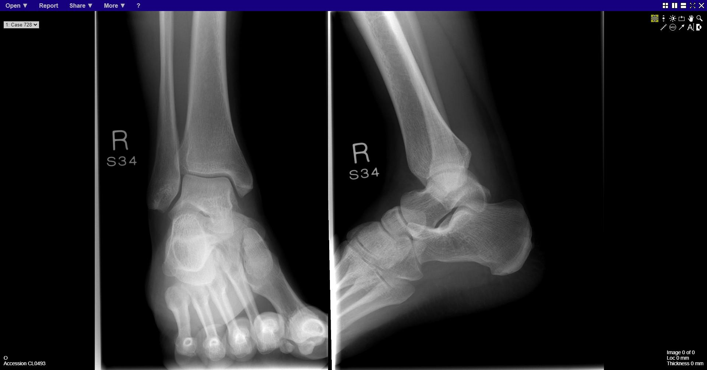
Notes:
normal

Slide 9
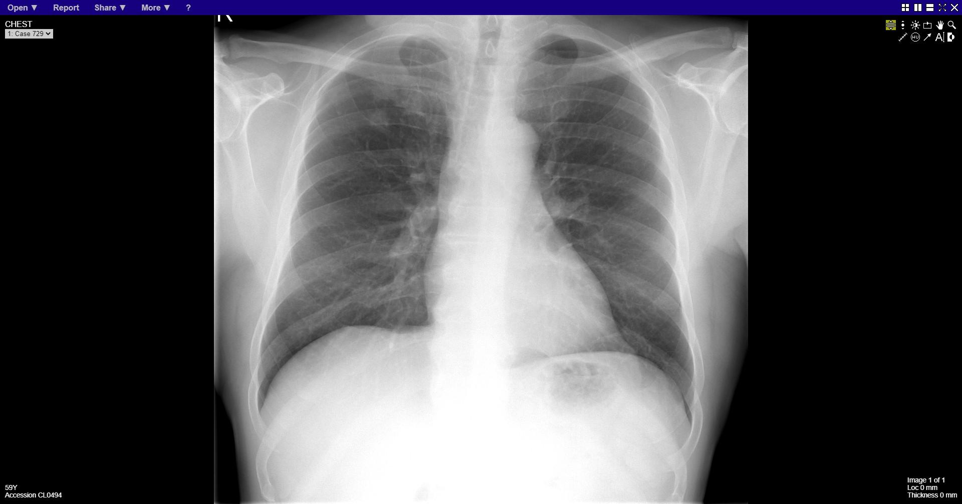
Notes:
Right upper lobe opacities

Slide 10
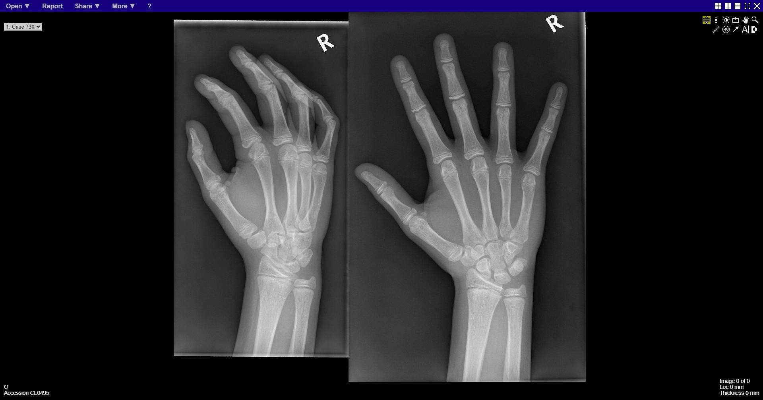
Notes:
normal

Slide 11
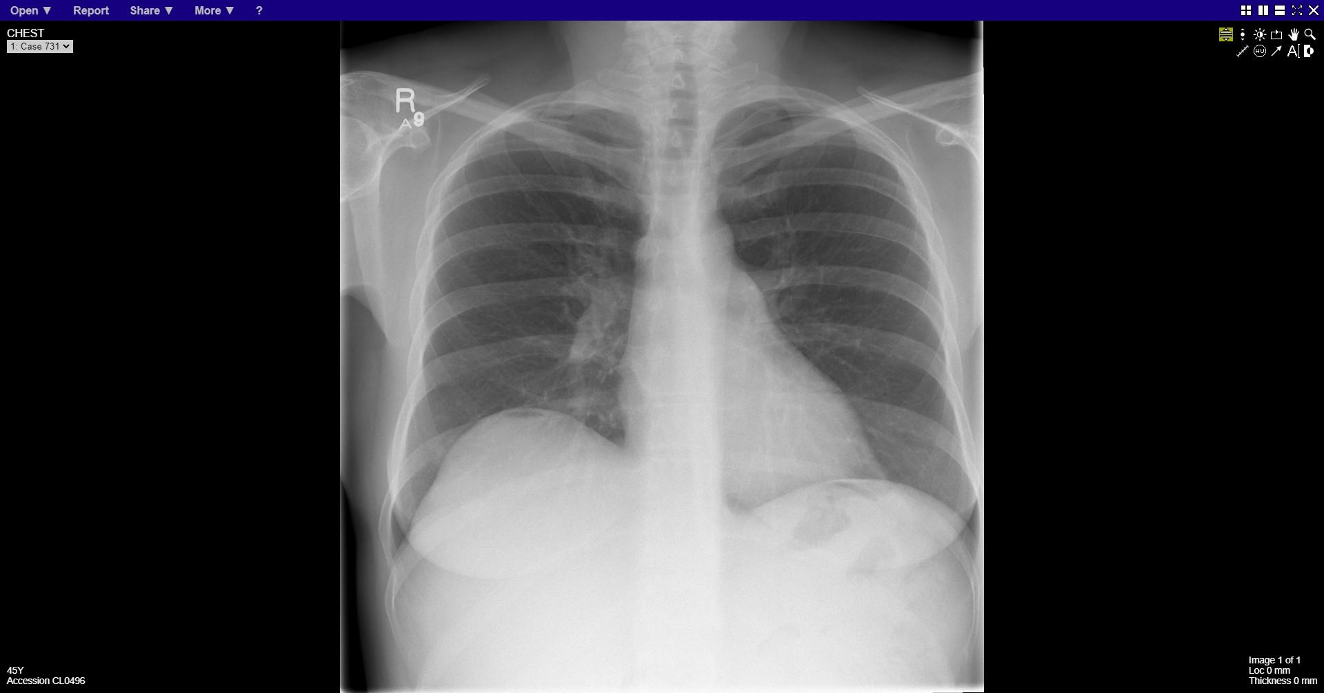
Notes:
Pneumoperitoneum

Slide 12
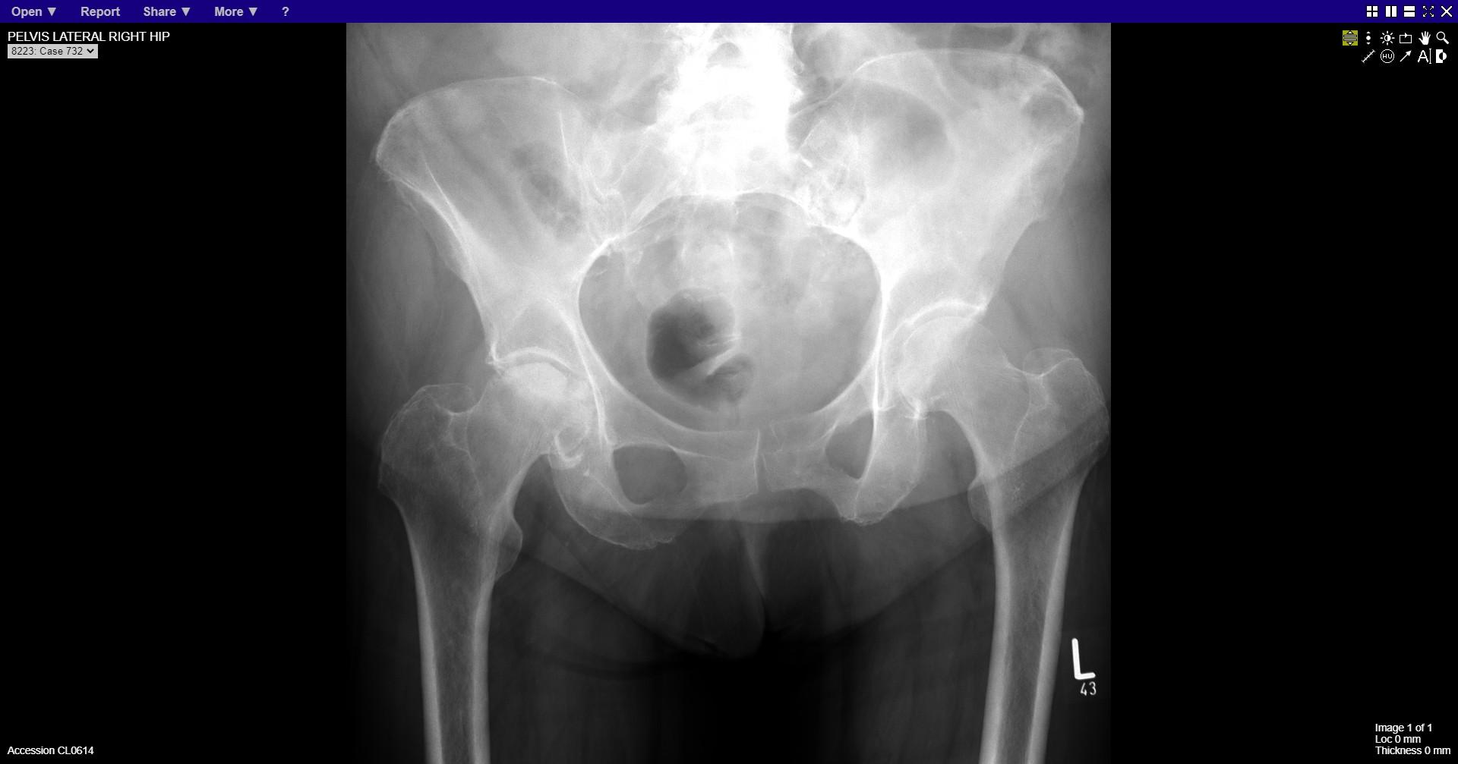
Notes:
Avascular necrosis right femoral head

Slide 13
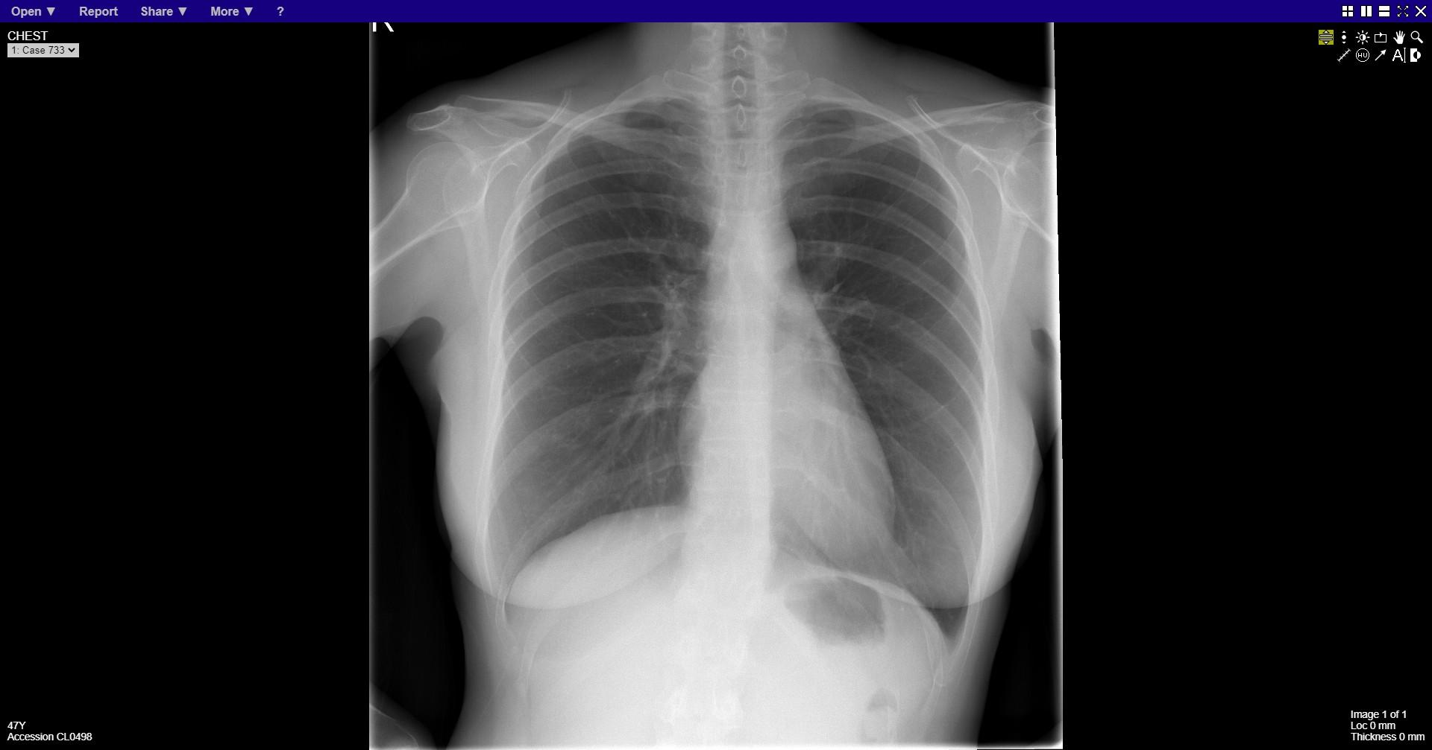
Notes:
Normal

Slide 14
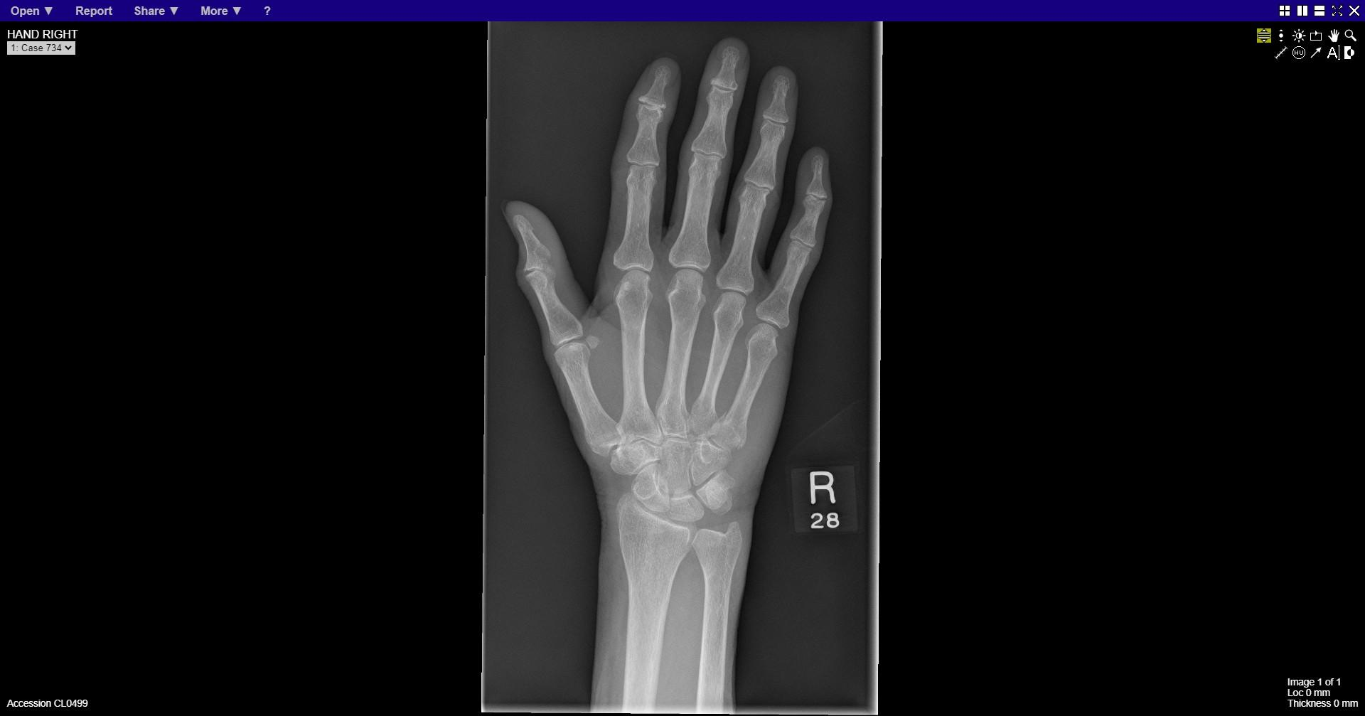
Notes:
Fracture base of fifth metacarpal

Slide 15
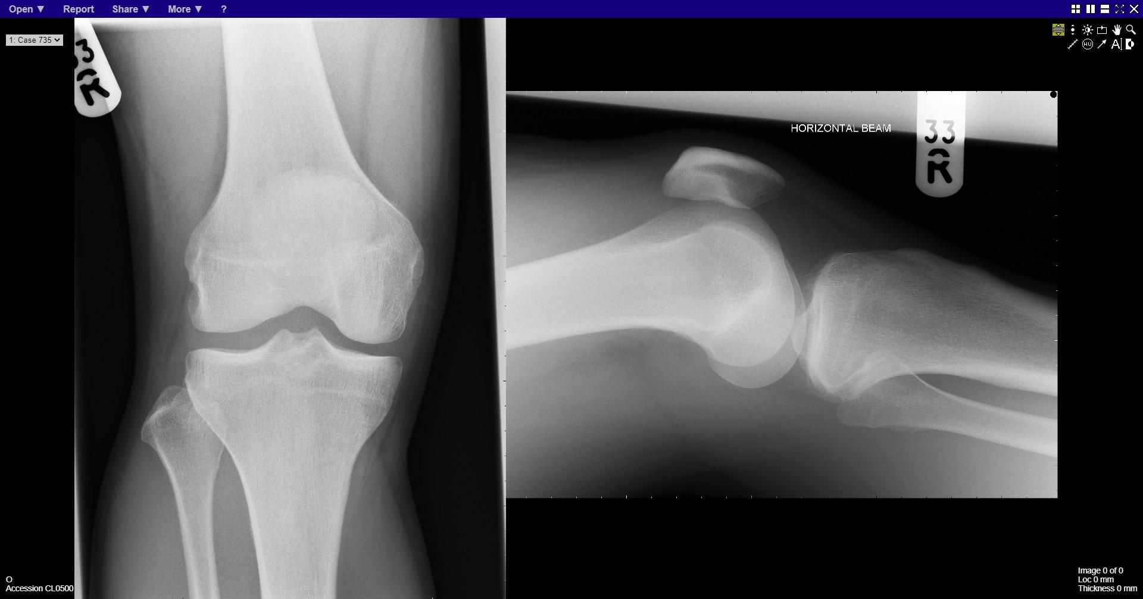
Notes:
normal

Slide 16
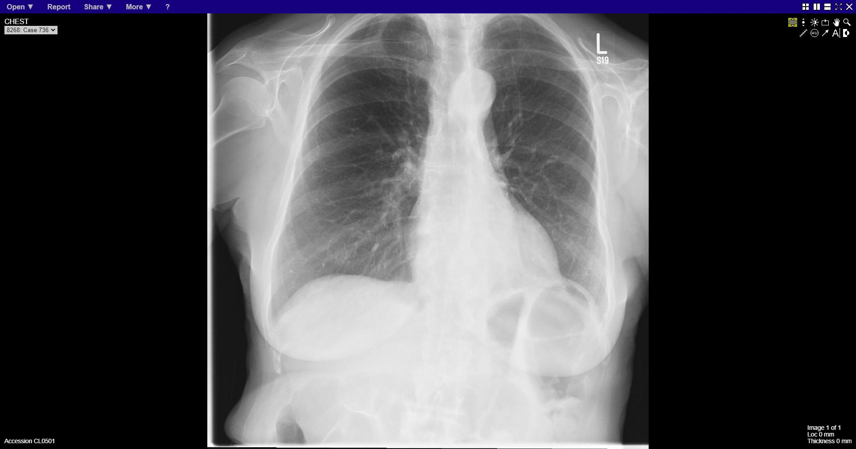
Notes:
Left lower lobe collapse

Slide 17
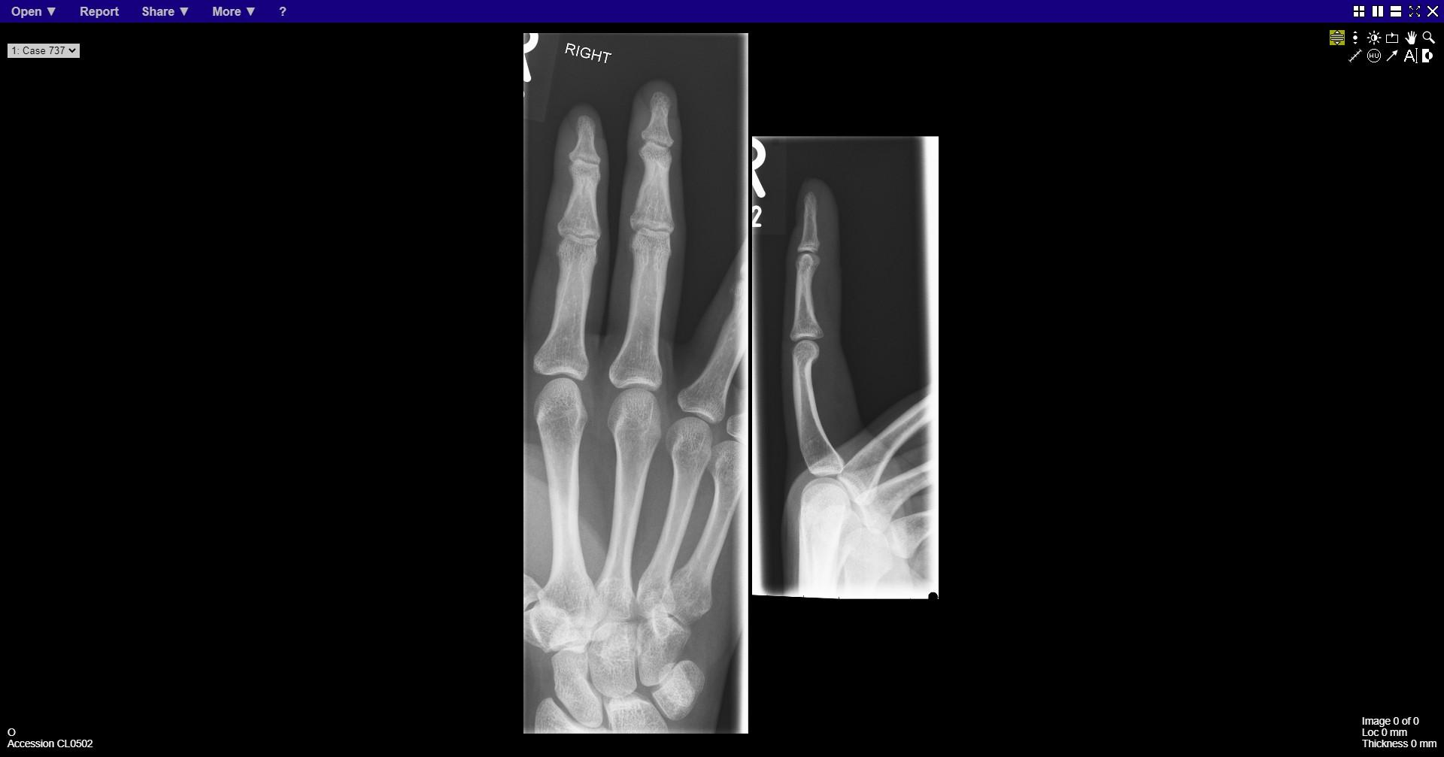
Notes:
normal

Slide 18
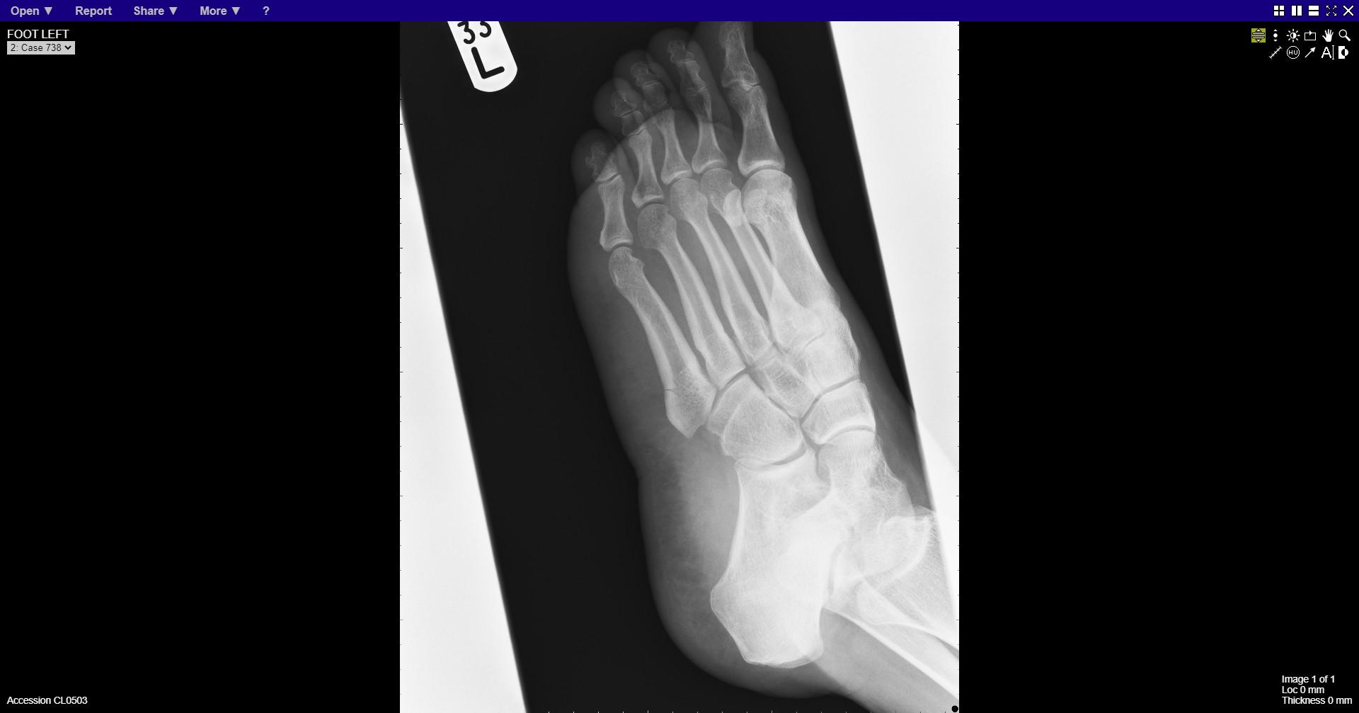
Notes:
Base of fifth metatarsal fracture

Slide 19
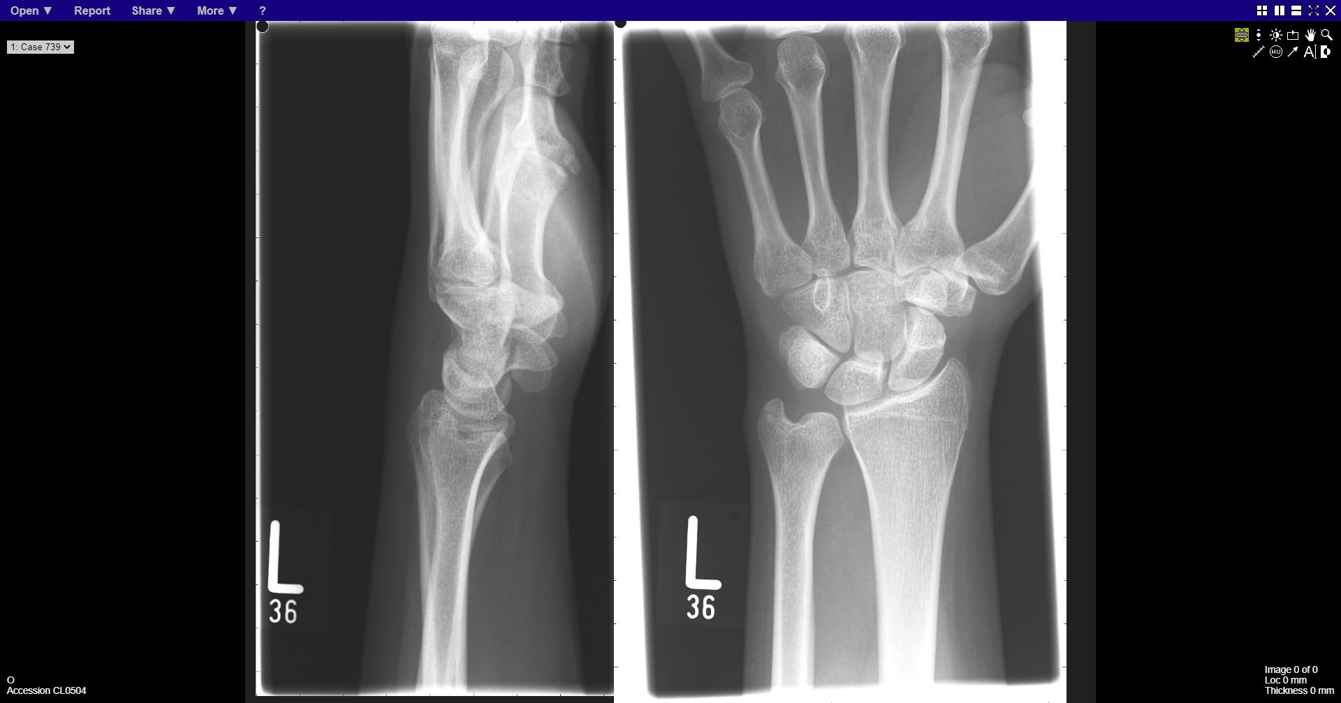
Notes:
normal

Slide 20
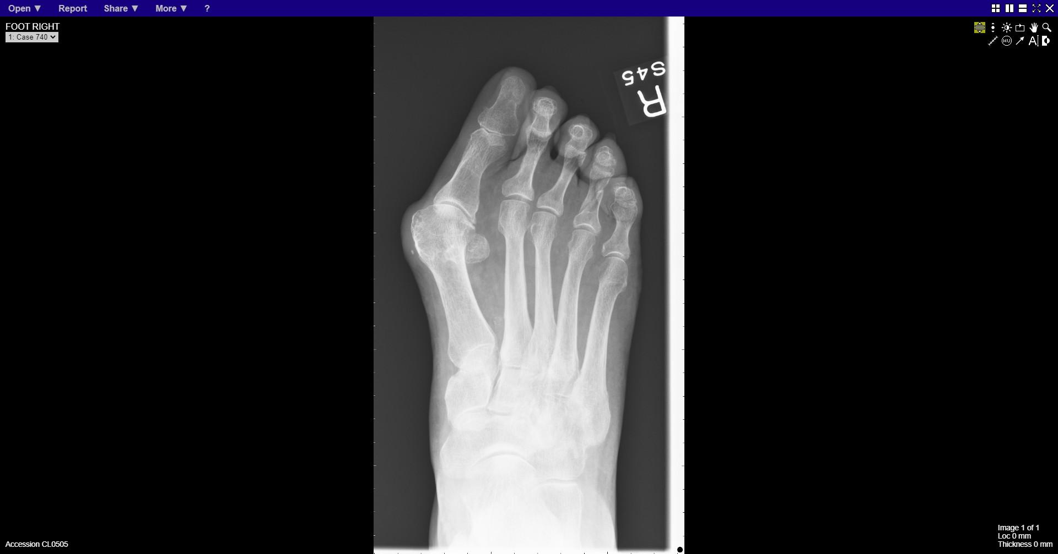
Notes:
Fracture proximal phalanx 4th toe

Slide 21
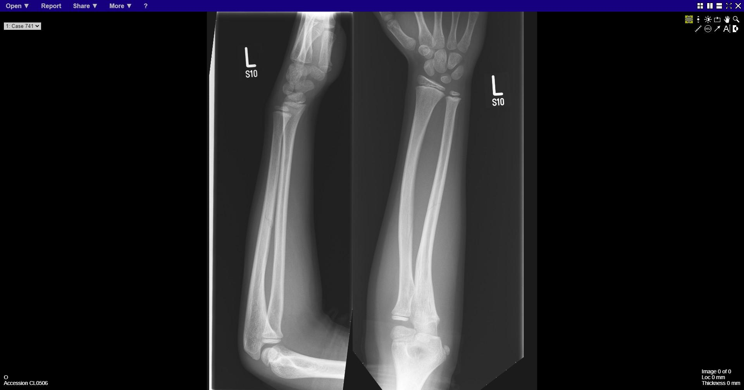
Notes:
Ulna shaft fracture

Slide 22
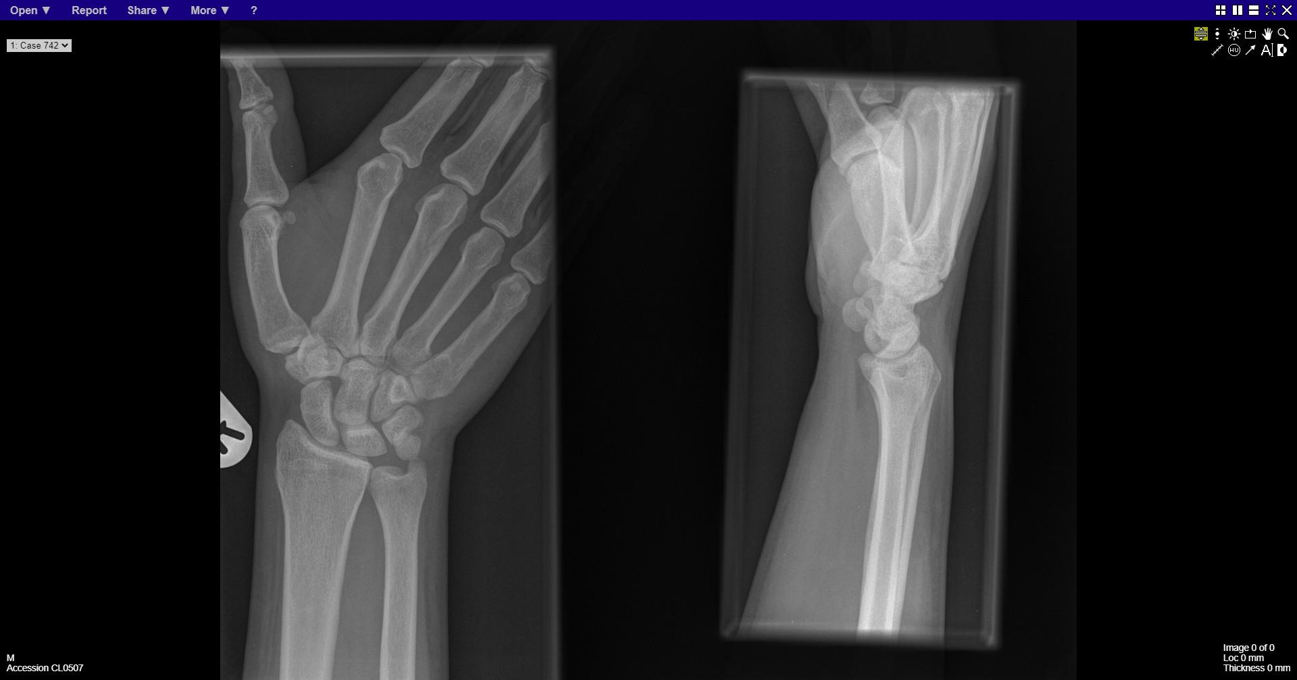
Notes:
normal

Slide 23
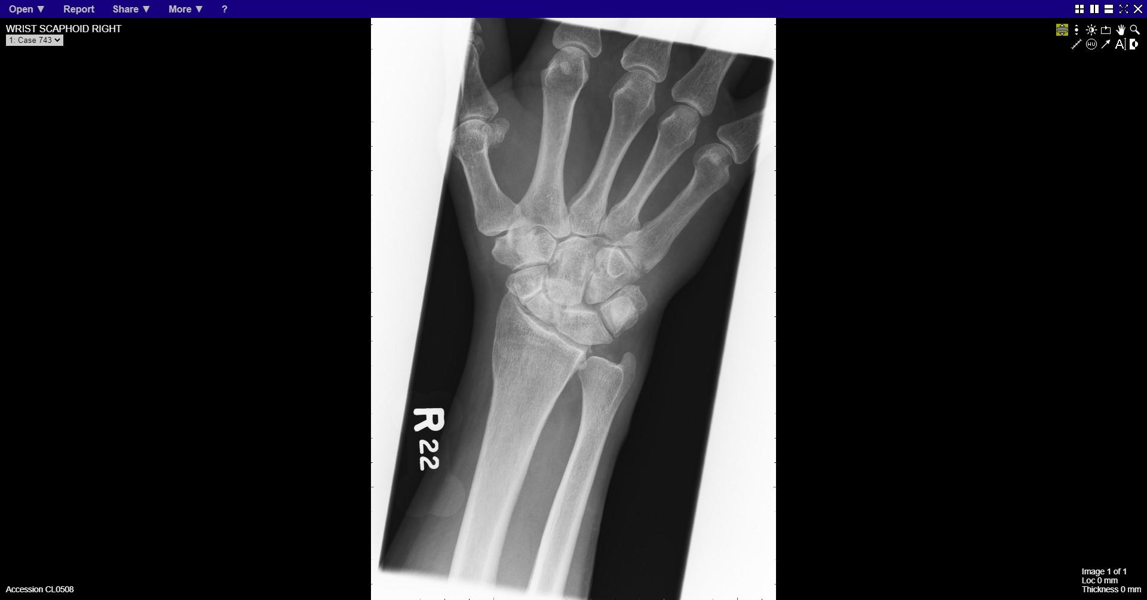
Notes:
Scaphoid fracture
Calcification in triangular fibrocartilage

Slide 24
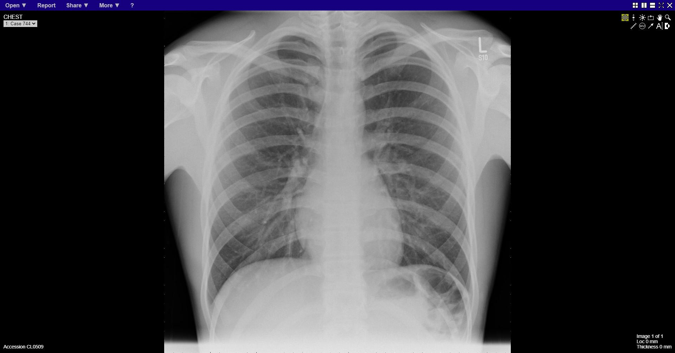
Notes:
Normal

Slide 25
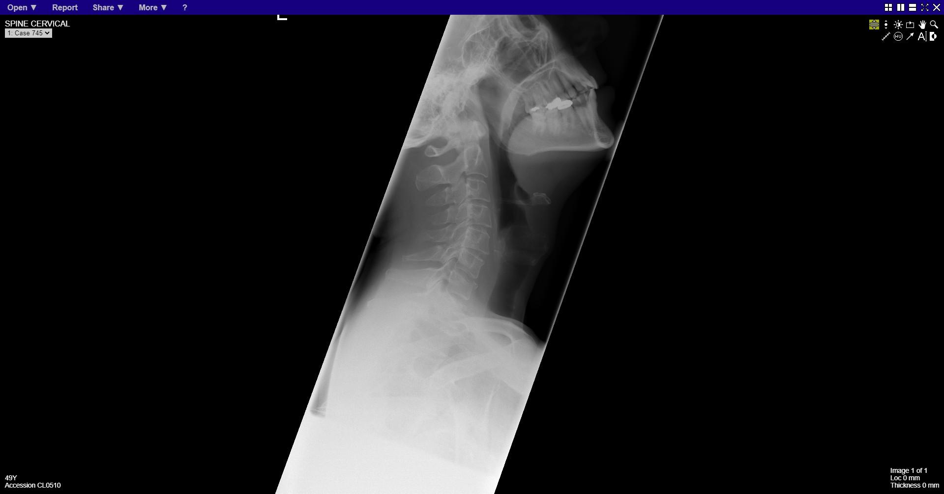
Notes:
Fracture anterior C7 vertebral body

Slide 26
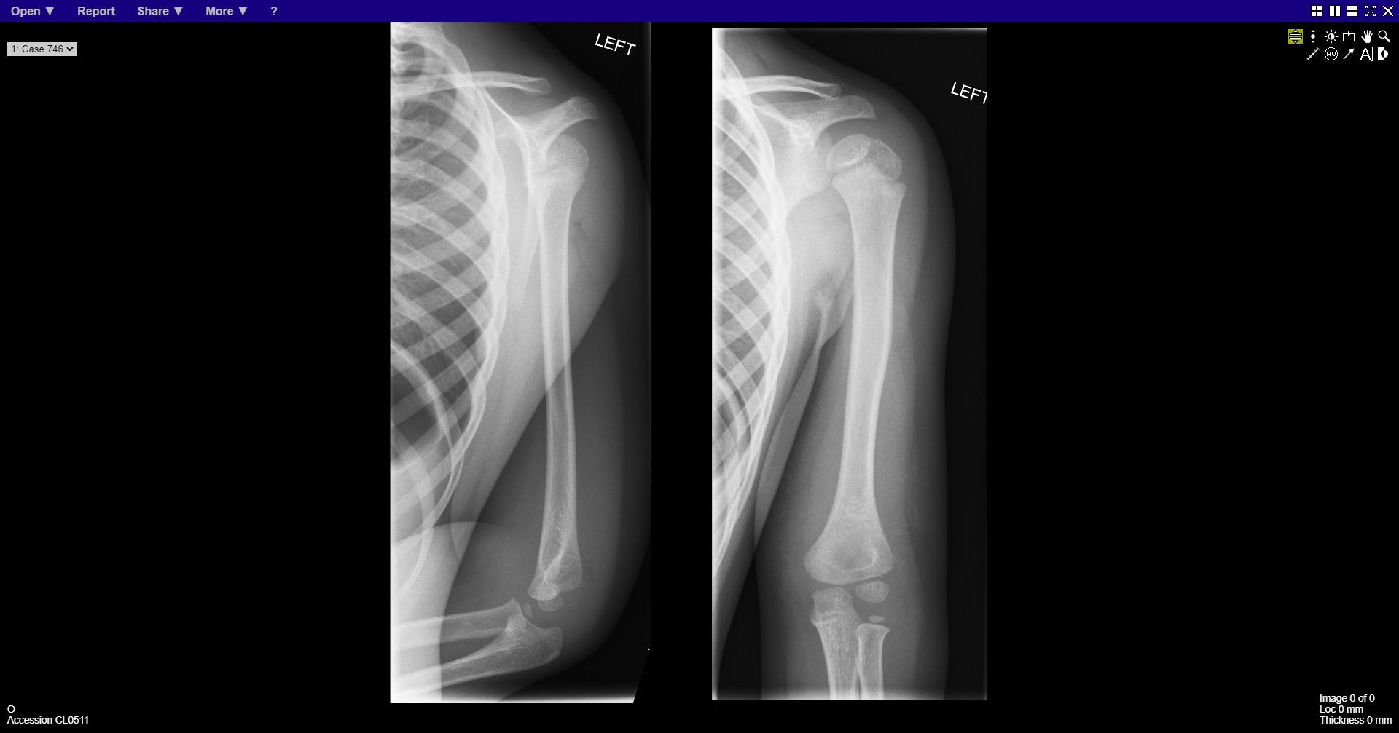
Notes:
Supracondylar fracture
Distal humeral fracture

Slide 27
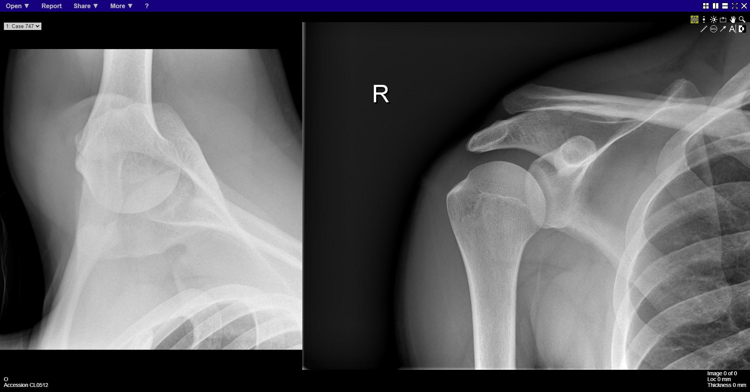
Notes:
Acromioclavicular joint dislocation

Slide 28
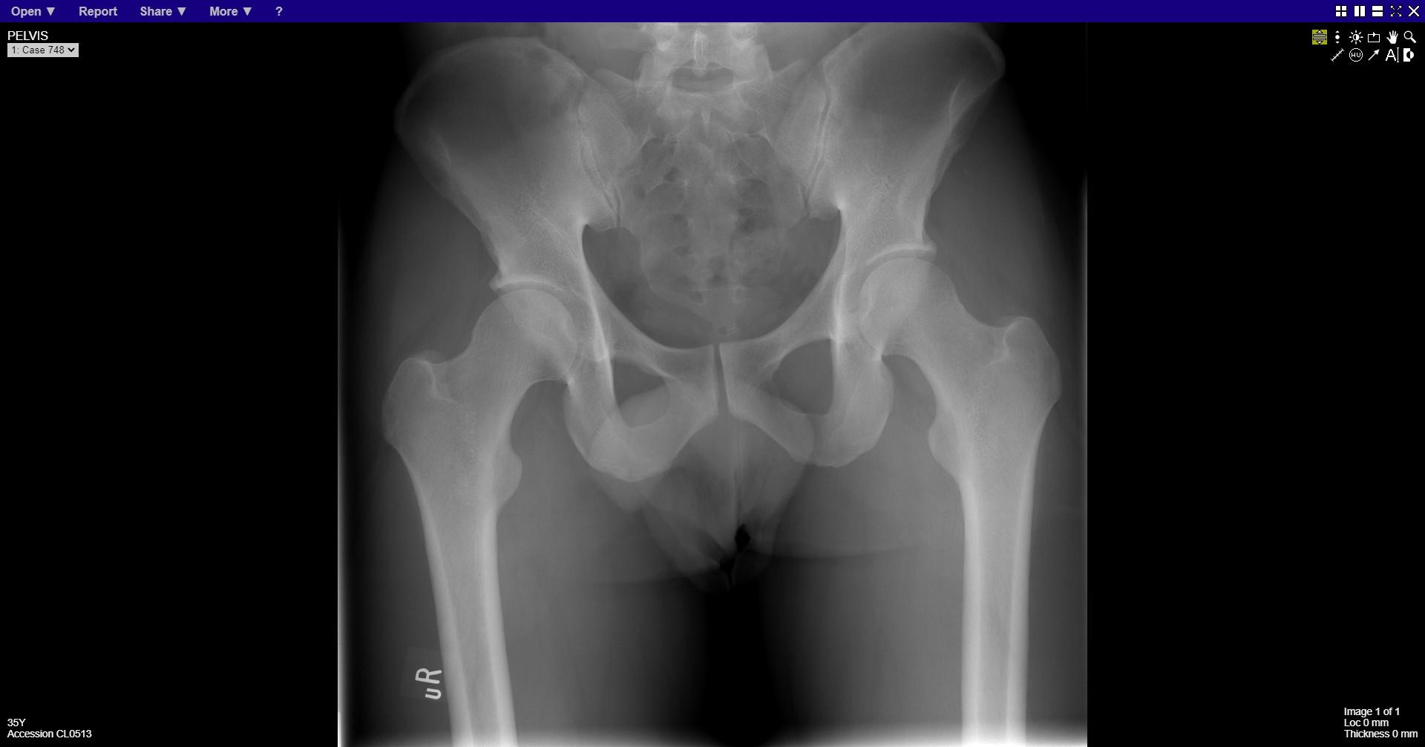
Notes:
normal

Slide 29
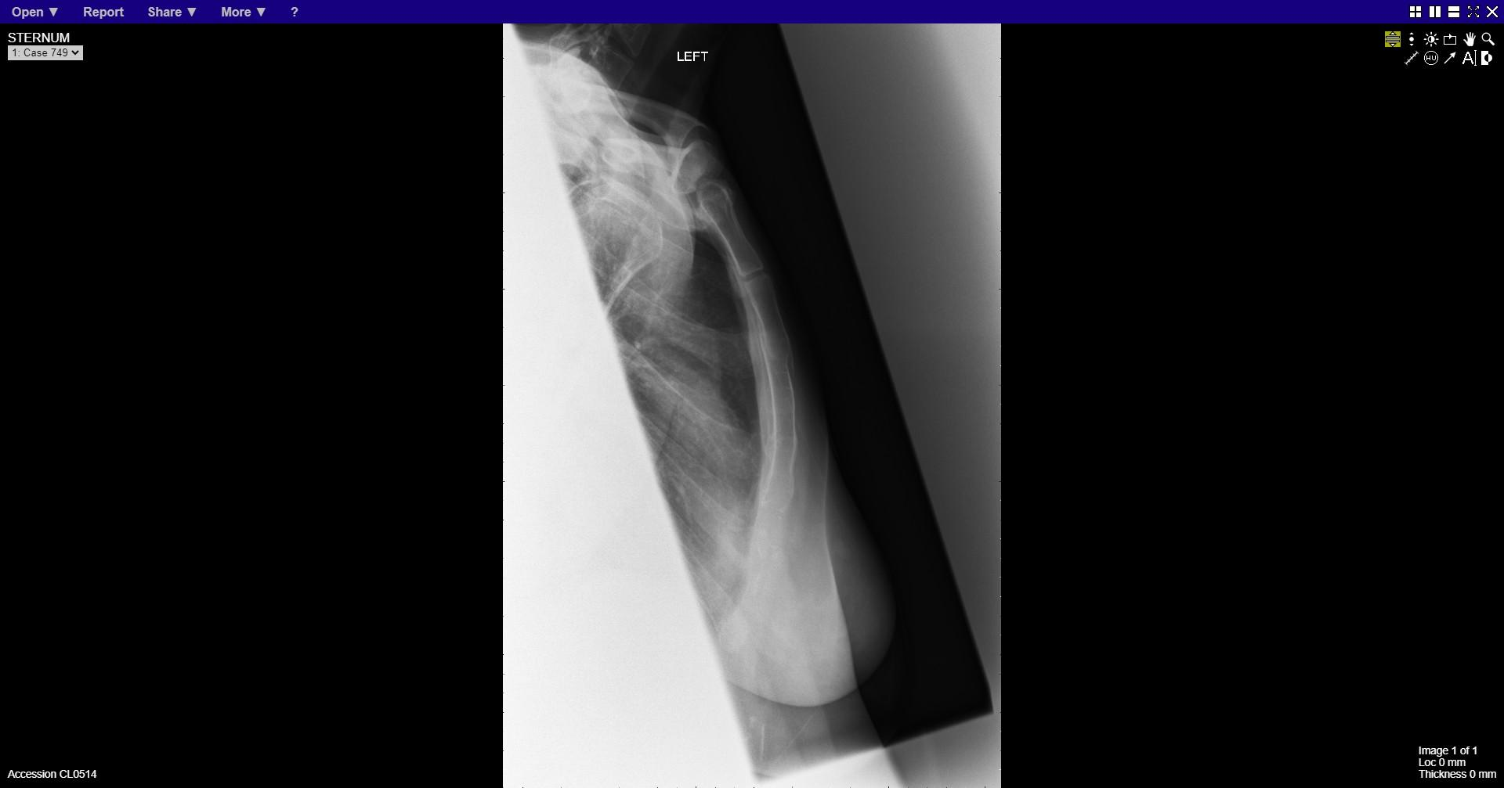
Notes:
Sternal fracture

Slide 30
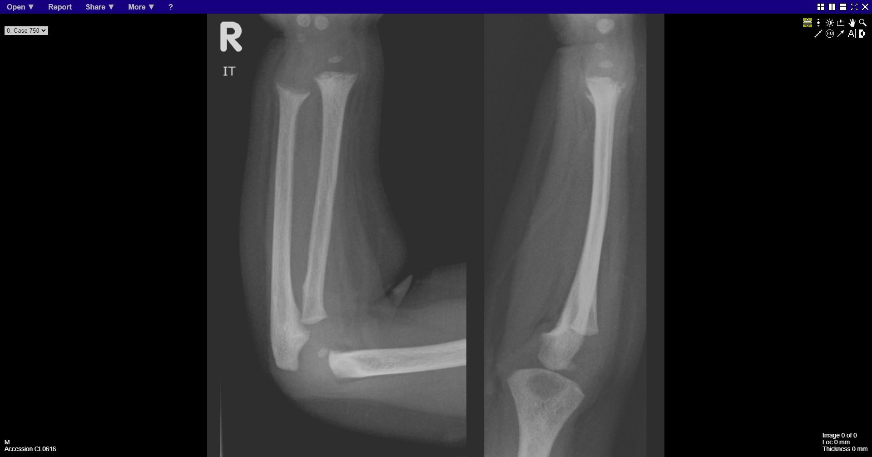
Notes:
Rickets

